Slide 1

Big O and ADT
Data Structures
Dr. Bouchaib Falah

Slide 2
Implementation➔Performance
Given an implementation using a specific (C) data structure, we can talk about the efficiency or performance of different operations.
How do you measure efficiency?
Time: Time needed to run a program
 Asymptotic Analysis
Space: Amount of memory needed to run a program

Slide 3
Efficiency: Space vs. Time
Time efficiency is usually more critical than space efficiency.
Some data structures require extra memory to help organize the data.
Some algorithms require copying data but the additional space needed, if necessary, can always be found in auxiliary storage.
There is often a space-time tradeoff:
E.g. reducing primary memory use by using disk space to store data, increases time to access the data because disk access is slower than primary memory access
E.g. using “invalid days” in our calendar wastes a bit of space in memory but makes accessing a specific day & month easier (simplifies computation).

Slide 4
Efficiency: Time
Time efficiency is measured in terms of number of critical operations (e.g. lookups/accesses)
It is expressed as a function of the size of the dataset.
It may be constant
In a function such as 0.1n² + 10n + 500:
At very small values of n, most of the cost is coming from the constant component
As n gets larger, 10n takes on more importance
As n gets larger still, 0.1n² is more important
So, as n grows larger and larger, the function becomes more nearly proportional to n²

Slide 5
Asymptotic Notations
A way to evaluate the efficiency of an Algorithm by estimating its « Growth Rate »
Growth Rate  the rate at which the cost of an algorithm grows as the size of the Input grows
Important  All sorting algorithms are executed with the same time complexity when the input is small i.e: 100 element
Three basic Notations:
Big-O: Upper bound – Worst Case
Omega: Lower bound – Minimum required
Theta: Exact bound

Slide 6
Big O Notation
Given two functions f(n) and g(n)
We say that f(n) is on the order of g(n) or f(n) is a Big O of g(n) i.e. O(g(n))
If there exist positive integers c and n₀ such that f(n) ≤ c * g(n) for all n ≥ n₀.
Other interpretations of f(n) being O(g(n)):
f(n) is asymptotically bounded by g(n)
f(n) grows more slowly than g(n)

Slide 7
Big O Notation
Example1:
F(n) = 3n+2, F(n) = O(?)
3n+2 <= 5n FOR n >= 1  F(n) = O(n)
c = 5 & n₀ = 1
Example2:
F(n) = 6*2^{n}+n²
6*2^{n}+n² <= 7* 2^{n} FOR n >= 4
Meaning(Reminder):
The upper bound  The worst case (When n grows larger)

Slide 8
Big-O Rules
The Sum rule:
IF T(n) = T₁(n) + T₂(n)
THEN T(n) = O(max(T₁(n), T₂(n))
Exp: T(n) = n³ + n² = O(n³)
The Product rule:
IF T(n) = T₁(n) * T₂(n)
THEN T(n) = O(T₁(n) * T₂(n))
Exp: T(n) = n³ * n² = O(n⁵)
The Scalar rule:
IF T(n) = K * T₁(n)
THEN T(n) = O(T₁(n))
Exp: T(n) = 7 * n³ = O(n³)

Slide 9
Big O Notation - Properties
Transitivity:
If f(n) is O(g(n)) and g(n) is O(h(n)) then f(n) is O(h(n)).
Polynomial Functions:
f(n) = a (a constant function) is O(1) since, by setting c = a and n₀ = 1, f(n) = a ≤ 1*a for all n
a*n is O(n^{k}) for any constant a How? Setting c = a and n₀ = 1, c*n ≤ c*n¹
n^{k} is O(n^{k+j}) for any j >= 0 since How? Setting c = 1 and n₀ = 1, n^{k} ≤ 1*n^{k+j}
If f(n) is any polynomial c₁*n^{k} + c₂*n^{k-1}+… c_{k}*n + c_{k+1}, f(n) is O(n^{k}) and f(n) is O(n^{k+j}) for any j ≥ 0

Slide 10
Big-O Notation
Theorem:
IF T(n) = a_{m} n^{m} + a_{m-1} n^{m-1} + ….. + a₁ n + a₀ Then T(n) = O(n^{m})
Note:
Typical Growth Rates:
O(log(n))<O(n)<O(nlog(n))< O(n²)< O(2^{n})

Slide 11
Big O Notation
Although there may be many functions by which f(n) is asymptotically bounded, we look for a function that:
Has a single term
Has a coefficient of 1
Is as close a fit as possible
If f(n) is a constant or polynomial, its asymptotic boundary can always be the highest term with a coefficient of 1
For other functions, such a tight fit may not always be possible

Slide 12
A Hierarchy of Functions
For any constants c, j, k, and d > 1
c is O(1)
c*log_{k} n is O(log n) [ NOTE: log n is log₂ n ]
c*n = c*n¹ is O(n)
c*n*log_{k} n is O(n log n)
c*n*log_{k} n is O(n²) [ maximum needed for sorting ]
c*n^{k} is O(n^{k})[ polynomial – grow quickly]
c*n^{k} is O(n^{k+j}) for j >= 0
…

Slide 13
Counting the Time Complexity
Comments: No Time
Declaration: No Time
Expressions & Assignments: 1Time Unit
Iterations: the number of iterations times the time of included statements
Selections: Condition + The worst case

Slide 14
Exercise_1
A quadratic algorithm with processing time T(n) = cn² spends T(N) seconds for processing N data items.
How much time will be spent for processing
n = 5000 data items, assuming that N = 100 and T(N) = 1 s?

Slide 15
Exercise_2
A sorting method with “Big-Oh” complexity O(n log₁₀ n) spends exactly 1 millisecond to sort 1,000 data items. Assuming that time T(n) of sorting n items is directly proportional to n log₁₀ n, that is, T(n) = cn log₁₀ n,
Derive a formula for T(n), given the time T(N) for sorting N items, and estimate how long this method will sort 1,000,000 items.

Slide 16
Data Types
Definition:
The data type of a variable determines the set of values the variable can take
Simple data types:
Integer, real, char, …..
Structured Data Types:
Arrays, structures, files and sets

Slide 17
Abstract Data Types
An abstract data type is a mathematical set of data, along with operations defined on that kind of data
Examples:
int: it is the set of integers (up to a certain magnitude), with operations +, -, /, *, %
double: it’s the set of decimal numbers (up to a certain magnitude), with operations +, -, /, *

Slide 18
Abstract Data Types (Contd.)
The previous examples belong to what is called built-in data types
That is, they are provided by the programming language
But new abstract data types can be defined by users, using arrays, structs, classes (if object oriented programming), etc.

Slide 19
Data Structures
A data structure is a user-defined abstract data type.
A data structure is a specific way of implementing an ADT.
Examples:
Complex numbers: with operations +, -, /, *, magnitude, angle, etc.
Stack: with operations push, pop, peek, isempty
Queue: enqueue, dequeue, isempty …
Binary Search Tree: insert, delete, search.
Heap: insert, min, delete-min.

Slide 20
Object-Oriented Programming (OOP) And Data Structures
When implementing a data structure in non-OOP languages such as C, the data representation and the operations are separate
In OOP languages such as C++, both the data representation and the operations are aggregated together into what is called objects
The data type of such objects are called classes.
Classes are blue prints, objects are instances.

Slide 21
Dynamic Memory Allocation
One of the big limitations of the first high-level PLs, FORTRAN & COBOL: When declaring an Array, a structure …, the programmer had to guess the largest size;
memory space is reserved till the program is over
Especially, for arrays, the Max_Size has to be defined in advance. “What if the array is not fully occupied” - “What if elements of an array are deleted?” : Space is still there  Waste of memory - Difficult to manage (add/insert/delete)
C does not have this limitation because of Dynamic Memory Allocation.
 DMA is meant to make optimal use of memory.
 Allocate and de-allocate memory as needed.
Notes:
DMA: You can “dynamically” - as needed- control the amount of memory you use

Slide 22
Dynamic Vs. Static memory Allocation
SMA requires that the number of bytes reserved for a variable cannot be changed during run time.
This is the technique you have used so far.
Ex: char Array[77], 77 bytes are reserved for the array through the whole program execution time.
DMA uses predefined functions to allocate & release memory for data while the program is running.
SMA uses declarations & definitions
DMA uses predefined functions

Slide 23
Memory Management Functions
You can “dynamically” - as needed- control the memory.
If you need memory  you ask for it.
Once you do not need it any more  you free it.
Two C functions for allocating memory:
malloc (Memory Allocation)
calloc (Contiguous Memory Allocation)
One C function to release/free the memory:
free
“The three functions are defined in <stdlib.h>”

Slide 24
Malloc: Memory Allocation
Used to allocate a single memory block of any built-in or user-defined type
Syntax:
malloc (sizeof (data_type))
sizeof returns the number of bytes need for the declared data_type
The returned pointer should be cast to the specific type needed.
Ex:
ptr_1 = (char *) malloc ( sizeof (char))
ptr_2 = (stud *) malloc ( sizeof (stud))
(stud is a struct)

Slide 25
Calloc: Contiguous Memory Allocation
Used to allocate memory for arrays of elements of any built-in or user-defined type.
It takes two arguments:
The number of elements in the array
The size of the data type of elements
Syntax:
calloc ( n, sizeof( data_type))
calloc should be cast too as with malloc
Ex:
array_1 = (char *) calloc(21, sizeof ( char))
array_2 = (stud *) calloc(77, sizeof (stud))

Slide 26
Free: Freeing memory
Tip:
If memory space is not available, malloc & calloc return a NULL pointer.
Useful:
if (ptr = (type *)malloc(sizeof(type)) = = NULL) printf(“Could not allocate memory);
When memory allocated by malloc & calloc are no longer needed, they should be freed using the free function.
Syntax:
free(ptr)
exp: free(my_ptr)

Slide 27
Example:
Write a program that asks a teacher for how many students he has in a class, creates an array of “stud structures” and stores the information for each student.

Slide 28
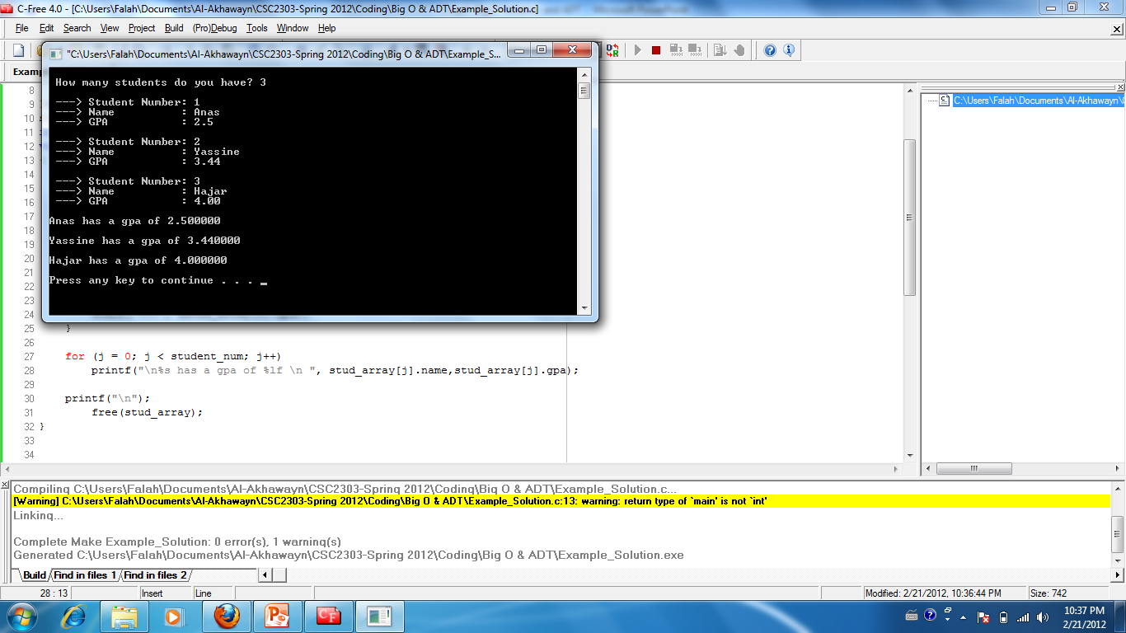
Example’s Output

Slide 29
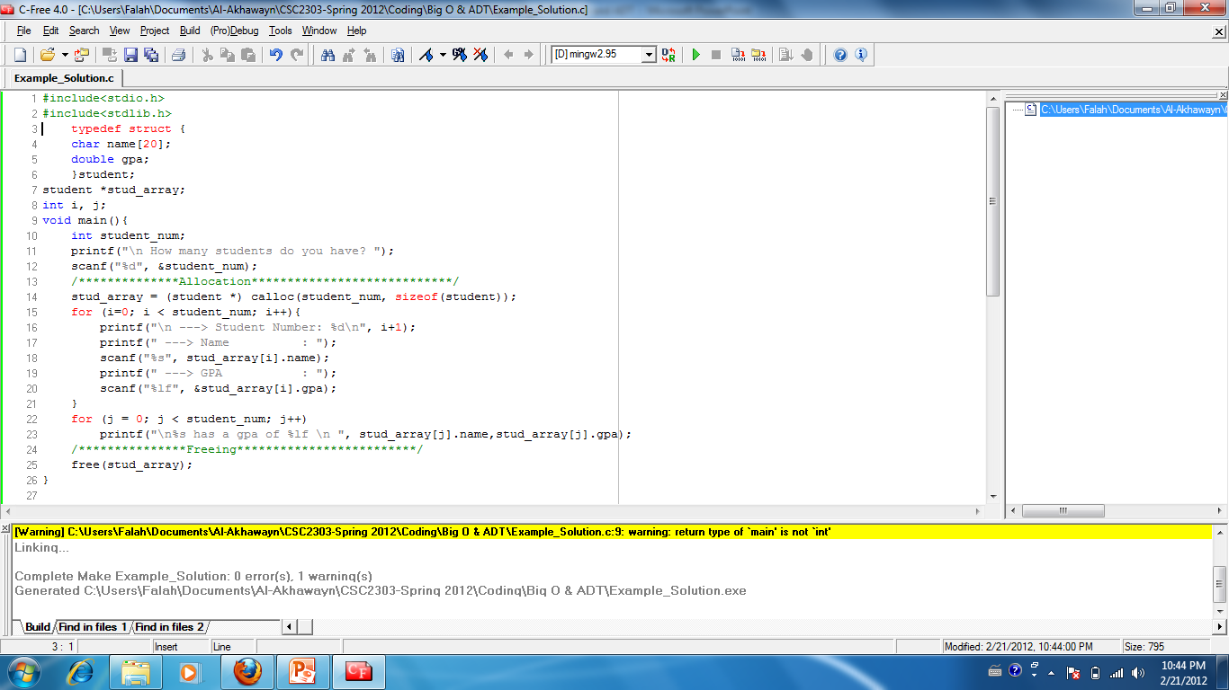
Example_Solution:

Slide 30
Be Prepared For Next Chapter
Iterative definition of a factorial function
1 if n = 0
factorial(n) =
n * (n-1) * (n-2) * …….. * 2 *1 if n > 0
Using this definition, write a program that prompts the user to enter a positive integer and executes its factorial.

